Slide 1
Structure of a Scientific Paper

Slide 2
Check journal specifications
We are presenting a general format for writing a scientific article but check journal specifications. They might want the sections to be named something else but the content will be largely the same
Some journals have word limits, figure limits, preferred reference formats, so make sure to check the Author Guidelines for your journal before you start writing

Slide 3
Think about the storyline...
Let's be honest, some scientific papers can feel dry and dull to read
The best papers have a flow, a story that they are following, with one concept leading logically into the next
Think about what you are trying to say, instead of just "present results", think about why it matters and lead the reader through the story of your research
Set the scene, highlight the problem, show how you addressed the problem, was it effective?
This will also make it easier to write!

Slide 4
Abstract
250-350 words (usually, but check journal specifications!)
It should set the scene, communicate the key findings, and why they're important
This is the first (and sometimes only) thing someone will read, so hook them!
General template:
General introduction to the field niche and knowledge gap
What aspects this paper focuses on, introduce the species/system
Key results
Importance/significance

Slide 5
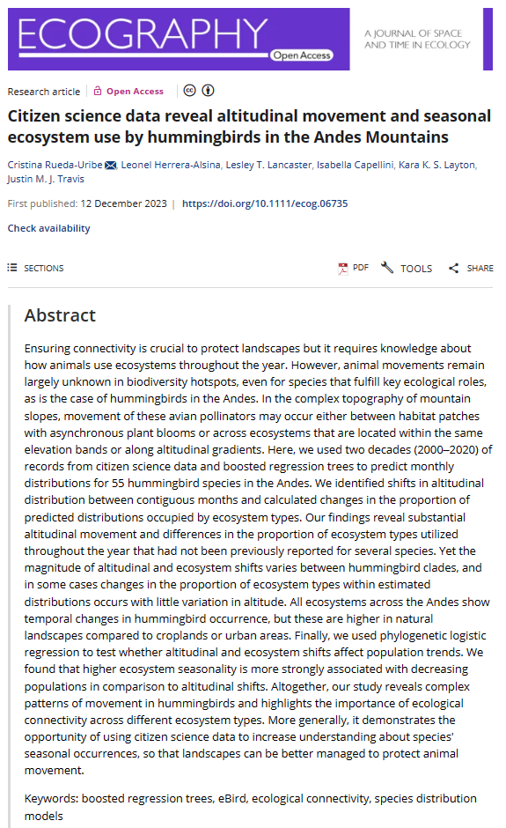
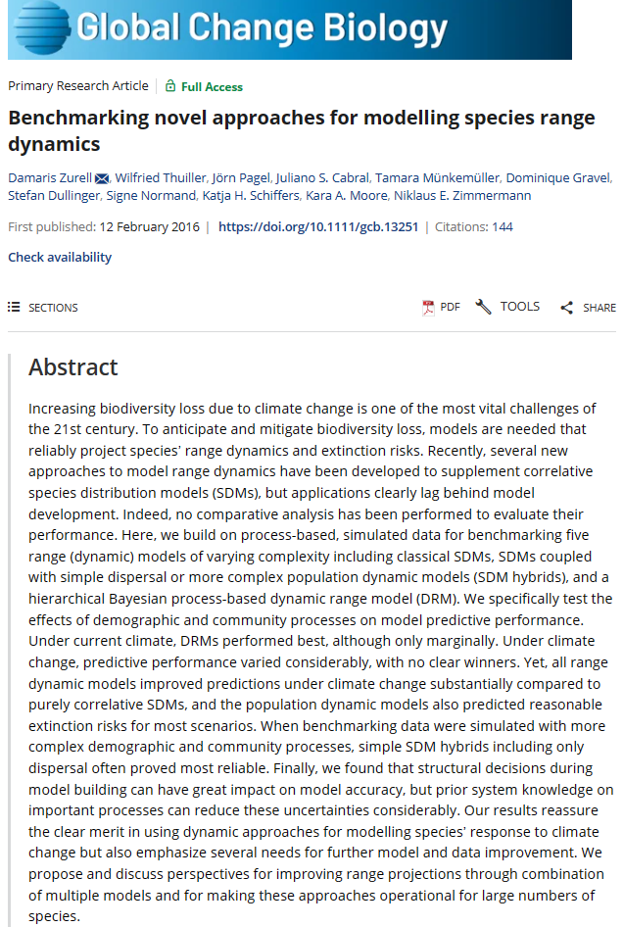

Slide 6
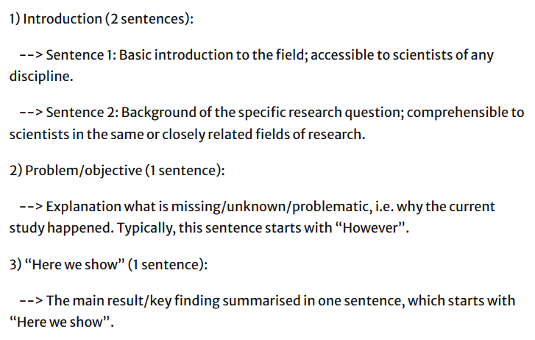
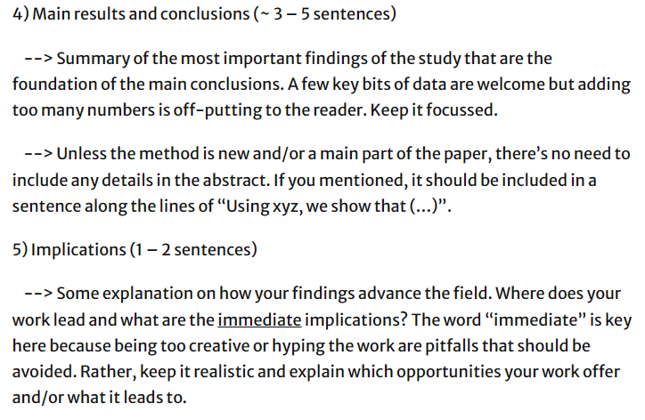
Exercise from Nature website
How to write an abstract | Research Communities by Springer Nature

Slide 7
Exercise
Think about your own research and brainstorm a couple sentences for each section (it's ok if you don't have key findings yet!)
Which ones are you struggling with?
Talk to your neighbours if you are not sure how to approach a certain point, or raise your hand and I will come round to chat to you!
Swap your abstract draft with a neighbour and give some general feedback. Does it present the context well? Does it highlight the importance?

Slide 8
Introduction (~1000-1500 words)
Here you have more space to give details on the background of the research topic, this is where you dive deep!
Gives the reader the information they need to understand the context you are working in
Reference heavy
Dive deep into the knowledge gap
Briefly describe what your work includes. This is not the place for any results! Only to introduce what you will present in the rest of the paper
Highlight the importance of this work within the context of the field
Notes:
Emphasise the difference between the abstract and the introduction

Slide 9

The funnel method
Start broad and work your way down to being very specific
Some readers will not have much context for your field, but you can assume some foundational knowledge. You don't have to start from zero

Slide 10
The funnel method in practice: Reuda-Uribe et al 2023
Effective conservation measures are limited by our understanding of the patterns and drivers of animal movement
The Andes Mountains in South America are an increasingly threatened hotspot for biodiversity but animal movement in these mountains remains understudied in comparison to temperate regions
Hummingbirds are specialized on a highly variable food resource and thus move to follow spatiotemporal variations in plant phenology
Increasingly popular citizen science databases offer an opportunity to investigate movement of populations in regions lacking movement ecology studies
In this study, we used two decades (2000–2020) of records from eBird to identify seasonal altitudinal movement and ecosystem use of hummingbird populations in the Andes Mountains.

Slide 11
Exercise
Looking at the abstract you worked on before, brainstorm some bullet points of what you could include in your introduction
Remember that this is where you can put detailed background information in! Give the reader what they need to understand your findings in context and their importance
Funnel down from broad to specific
Again, we are going to swap these with your neighbours!

Slide 12
Methods (~1000 words)
This will vary depending on your field and the type of journal you are submitting to so having an idea of your target journal ahead of time is useful
This might include:
Description of your study site (including maps)
Statistical methods you used for analysis, equations that you used
Survey methods you used in the field, how you collected specimens, why you chose to design your fieldwork in that way
Software that you used
How you set up your simulations
What parameter values you used for your models (and where you found them)
This section is for what you did

Slide 13
Results (~1000 words + Figures )
This is where you present your results, with figures, maps, tables, graphs etc
You give each figure a legend, describing what the reader should see (we will have more detail on writing legends tomorrow)
All Figures should be referred to in the Results text. If you are not referring to it, why is it in the paper? Talk about each result
This section should have a logical flow. One result might build on another or lead into the next, it should not feel random

Slide 14
The 'first sentence' method
Top tip: make your first sentence of each paragraph stand out so the readers remember it
Dedicate each paragraph to a particular result
Make your first sentence the 'take home message' of that paragraph. What do you want the reader to remember?
Then go into the finer details of the result. Even if the reader doesn't remember all of the information, they will remember the key result from the first sentence

Slide 15
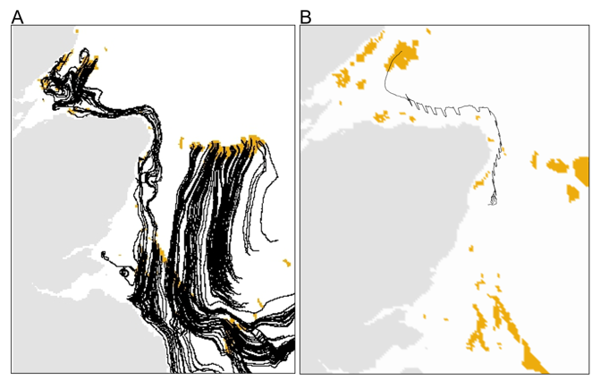
The 'first sentence' method example
Movement tracks move southwards
The top left corner has circular motion
Individuals leave the study site to the east
Individuals from the big patch in the middle don't reach many patches

Slide 16
The 'first sentence' method example
Imagine you have this figure in your paper
Brainstorm a few first sentences of the corresponding paragraph that communicates a take home message
There are several that you could choose from!
There is a lot of information on this map, you can focus on any aspect of it for your take home message sentence

Slide 17
The 'first sentence' method
What was published: "Prevailing currents move southwards along the coast before turning east at the bottom of our study seascape, transporting individuals outside of our domain "
Then, the paragraph goes into detail about individual patches, what it means for connectivity and dispersal within the system

Slide 18
A common mistake...
The results section only presents the results, it does not analyse them!
For example, you could present your study species' distribution (perhaps with a map) but you would not say why the distribution is restricted in certain places or what creates the spatial pattern
The results section is for what you found not why you found it!

Slide 19
Discussion (~1000-1500 words)
This is where you get to analyse and think critically about why the results are what they are
Go back to your storyline, this is where it really shines
Discuss each result in detail, talk about why you got this result, whether it is valid, what its implications are
Back up your conclusions with references! It is likely that your results back up other work, contradict other work, or follow well known concepts. These need to be referenced
Critically analyse your methods, show areas of development, further research ideas

Slide 20

The 'hourglass' method
Briefly remind the reader of the broad context of the paper but don't just repeat the introduction
Then get very specific about your results, discuss them with critical analysis
Then bring the focus back out and emphasise the importance of your work in the broader field

Slide 21
Conclusion (150-200 words)
Some journals require this, some don't and it is up to you whether you want to include it
This rounds out your paper and highlights the main take-home messages, emphasising again how important this work is

Slide 22
Acknowledgements (~100 words)
If there were people involved who are not authors on the paper but contributed in some way, this is where you thank them
This could be helping with data collection, sourcing data for you, giving advice on using a piece of software/tool
Ethics and research permits, funding bodies, these need to be acknowledged!
Anyone who made the work possible but did not contribute to writing the paper

Slide 23
References
In your text, anything that is not your own observation/result needs to be referenced! Even if you think this is common knowledge, if you did not "invent" it, it needs to have a reference
Again, make sure you look at the journal specifications because sometimes they have their own template for references! Other times, they specify which format you should use
If your references are in the wrong format, you will have to fix it in the reviewer's corrections or during the formatting phase. You might as well do it from the beginning!

Slide 24
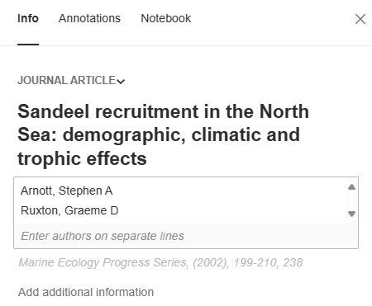
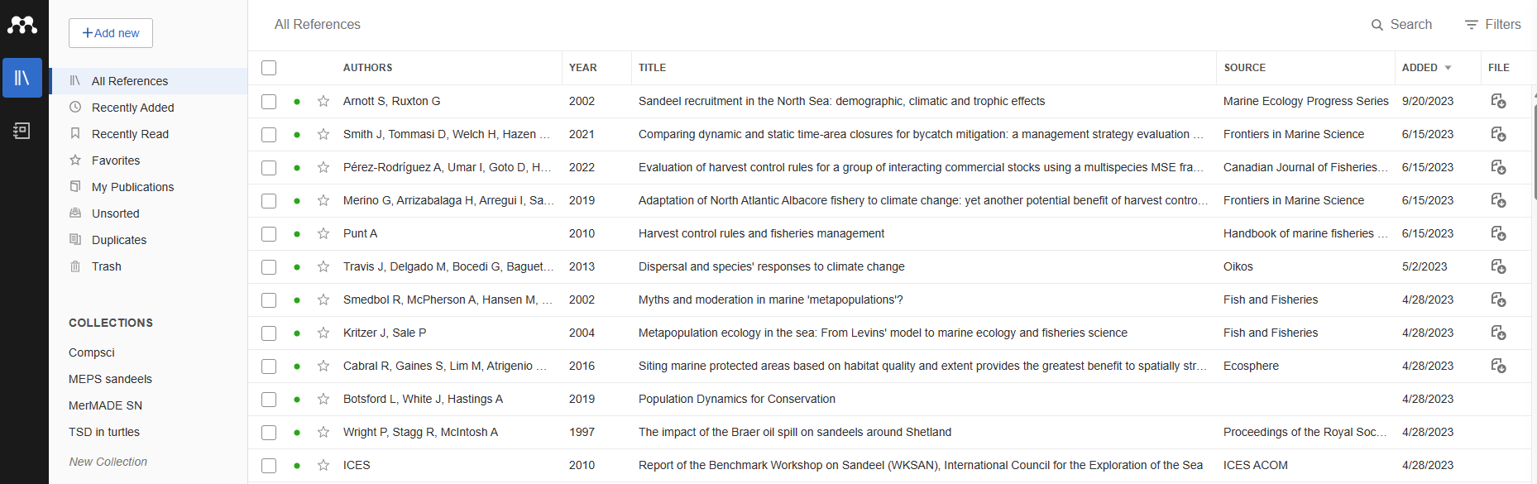
Reference Managers
Using software that takes care of your references for you can be useful, but be careful and double check that it has produced the reference accurately!

Slide 25
What to write first...
Everyone approaches this differently!
Sometimes it is encouraged to write the abstract first so that you have the storyline in your head, you know what the "hook" is, and why it's important
Sometimes it's easiest to write the methods first because you already know what you did
Sometimes it's good to condense your literature search into your introduction
You will find your own way that works for you
I recommend finding your storyline first, this makes the rest of the writing much easier

Slide 26
Any questions?

